Slide 1
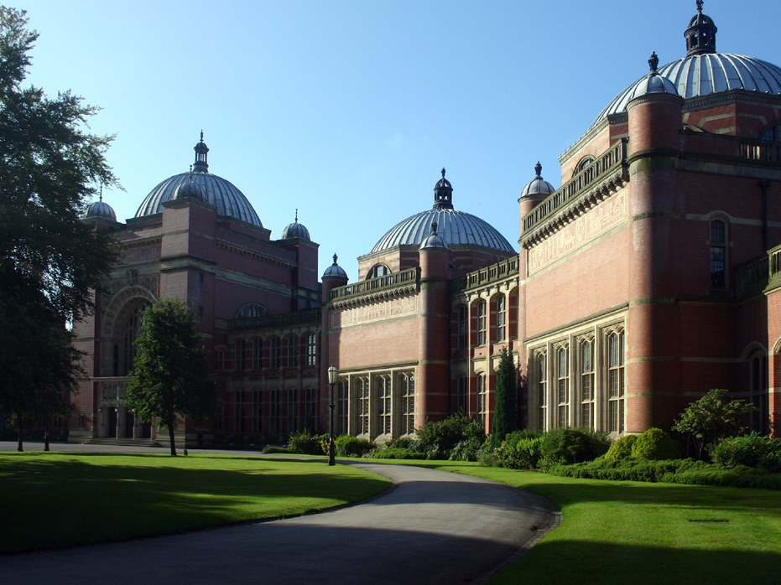
SELLING BIRMINGHAM
UNIVERSITY OF BIRMINGHAM
2022
UNIVERSITY OF BIRMINGHAM,EDGBASTON

Slide 2
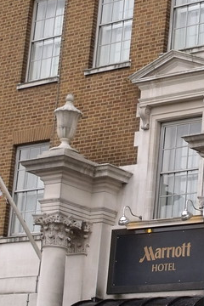
We are real estate agents in one of Uk’s most populous cities. We buy and sell properties within Birmingham. We have been given the task of creating a dashboard that our clients could use without any stress when trying to find the home of their dreams. Our data is obtained from Zoopla( www.zoopla.co.uk and Rightmove(www.rightmove.co.uk).
INTRODUCTION

Slide 3
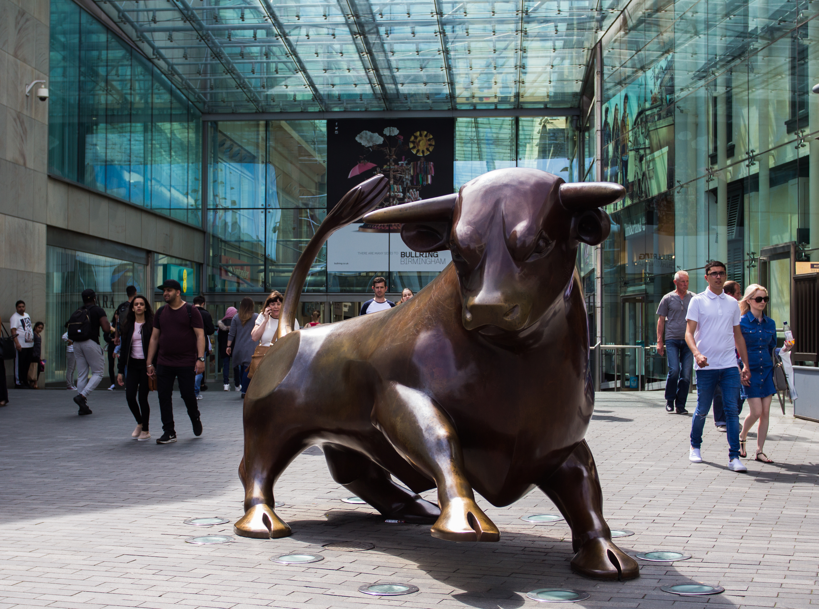
Group Members and JOB DESCRIPTION
Yevgeniy Denkovych: Data Scraping
Shola Daropale: Clean and Load data into PostgreSQL
Tamani Kaid : Create website and visualization
Daniela Shae-Bebeyi: Ploting and visualization
BULLRING, CITY CENTRE.

Slide 4

Research QUESTIONS
What is the most expensive property type?
What is the best type of property to buy?
What is the worst type of property to buy?
What is the relationship between price and number of bedrooms?
What is the relationship between price and number of bathrooms?
Floodgate Street, Birmingham

Slide 5
Research OBJECTIVES
Understand the Birmingham property market.
Find out the most expensive property type to invest in.
Match the low , high and expensive areas with price and property type.
Understand the relationship between price and bathrooms
Understand the relationship between price and bedrooms.
Stand out amongst from other housing websites.

Slide 6
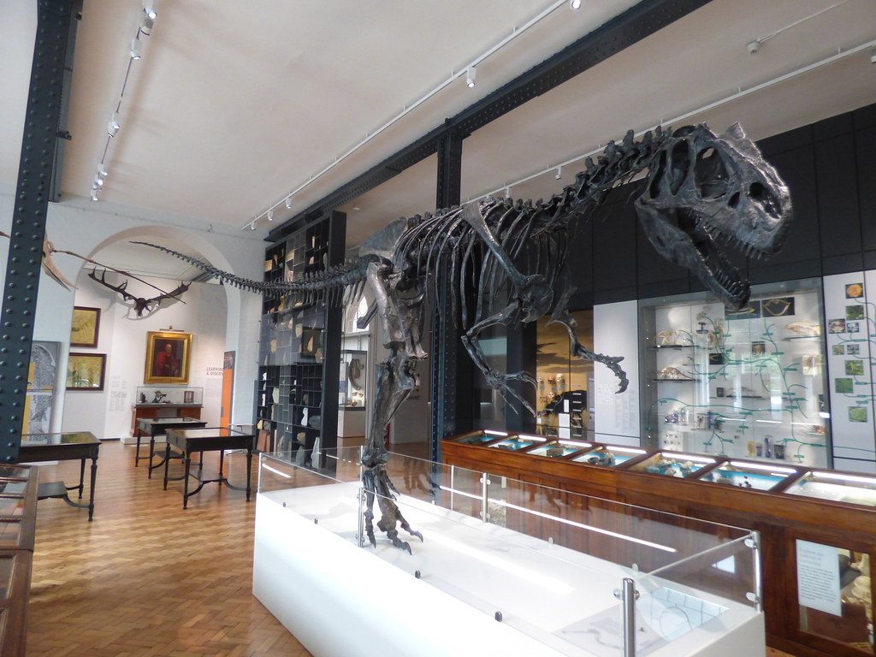
RESEARCH BASED ON: Web scraping the data Cleaning the data Loading into flask Creating a dashboard Creating a functional website
TECHNOLOGIES / LIBRARIES USED: PostgreSQL Selenium Beautiful soup Microsoft office Tableau GitHub Html and Css Flask Javascript
Plotly
D3
Tableau
Tabulator ( New Javascript library)
LAPSWORTH MUSEUM OF GEOLOGY, EDGBASTON

Slide 7

FACTS ABOUT Birmingham
Birmingham is the second largest city of the United Kingdom.
Birmingham is the largest city of the West Midlands conurbation.
The city lies approximately 110 miles (177 km) northwest of London.
It lies near the geographic centre of England at the crossing points of the national railway and motorway systems.

Slide 8
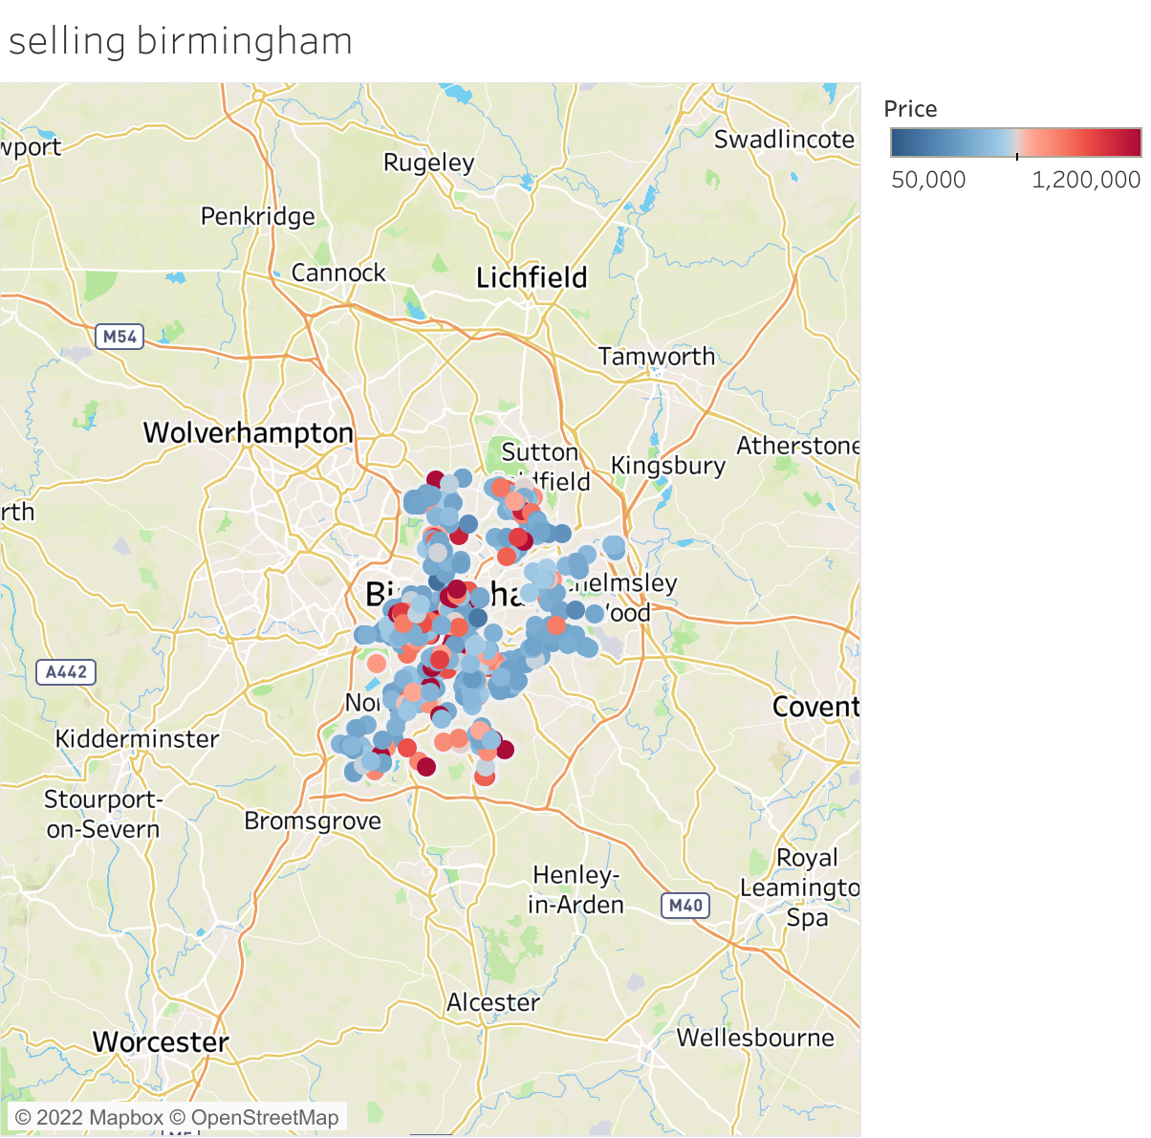
A View of Birmingham

Slide 9
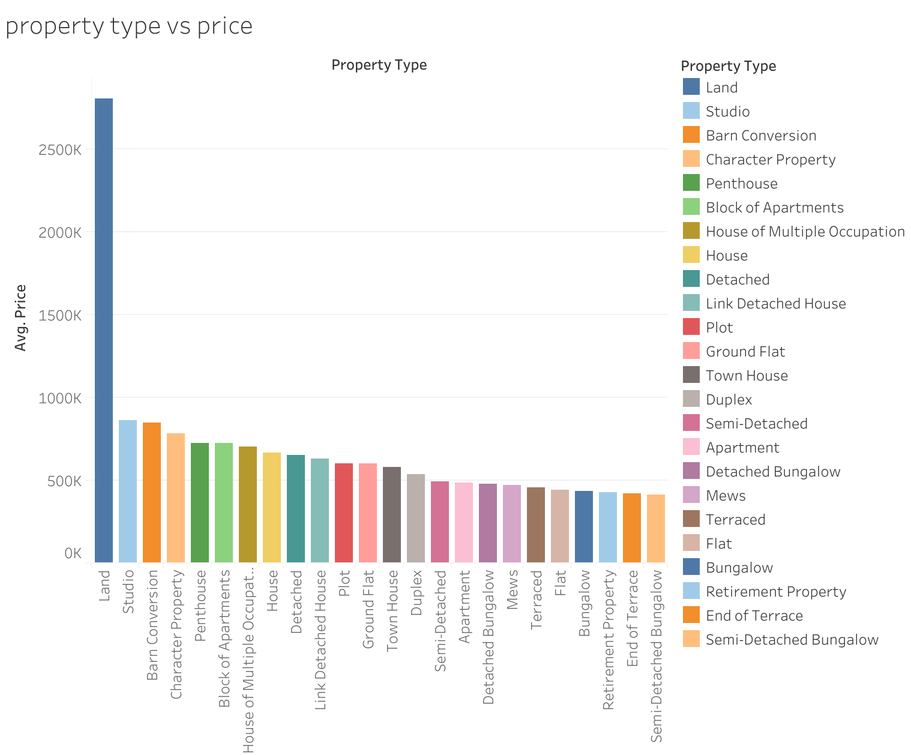
Analysis of property type and price
This is a bar graph that shows the relationship between the average price and property type.
From the analysis, it is evident that the price of land is most expensive than buying a house.

Slide 10
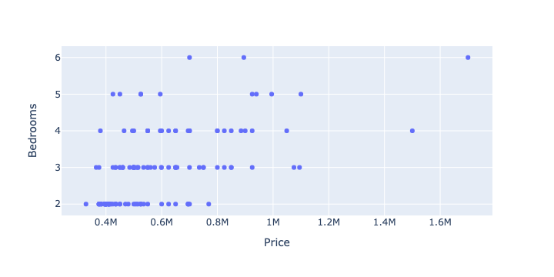
price and bedrooms
A SCATTER PLOT SHOWING A RELATIONSHIP BETWEEN PRICE AND BEDROOMS THE PRICE OF THE BATHROOM WAS MATCHED AGAINST THE NUMBER OF BEDROOMS. FROM THE ANALYSIS IT IS EVEIDENT THAT THERE IS A CORRELATION BETWEEN THE PRICE OF THE PROPERTY AND THE NUMBER OF BEDROOMS.
Price and Bedroom Analysis

Slide 11
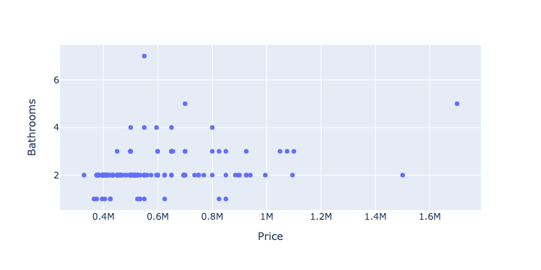
Price and bathrooms
A scatter plot showing a relationship between price and bathroom. The price of the bathroom was matched against the NUMBER OF BATHROOMS. From THE ANALYSIS IT IS EVEIDENT THAT THERE IS A CORRELATION BETWEEN THE PRICE OF THE PROPERTY AND THE NUMBER OF BATHROOMS.
Price and Bathroom Analysis

Slide 12
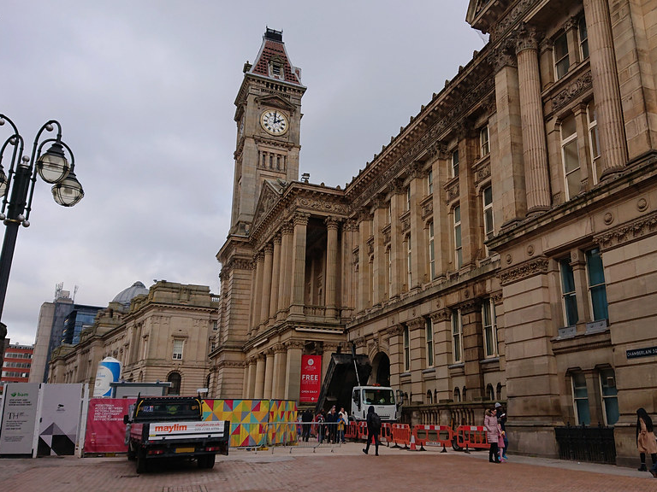
KEY CONCLUSIONS and recommendation
The Birmingham property market is very lucrative.
Birmingham is an amazing place to invest in and live in
Buying land is a better investment.
The number of bedrooms affects the price of a building.
The number of bathrooms affects the price of a building.
For long term investment buy land and develop over time.
Birmingham’s market can be easily accessible by low, medium and high-income individuals.
Town Square , Birmingham

Slide 13

TABULATOR ( JAVA SCRPT LIBRARY)
Tabulator is a plain JavaScript library and can be used on all frontend JavaScript Frameworks.
Tabulator uses a virtual DOM to enable it to process 100,000's of rows without a performance overhead.
The virtual DOM works by only building the rows that are visible on the screen. As you scroll through the table, rows are created and destroyed as they enter/leave the of the visible area of the table.

Slide 14

CHALLENGES ENCOUNTERED
Validity of the data source
Messy data due to high volume of data
Time consumption
Quality of Data
Selecting the right analytics tool.
NATIONAL SEALIFE , BRINDLEY PLACE

Slide 15
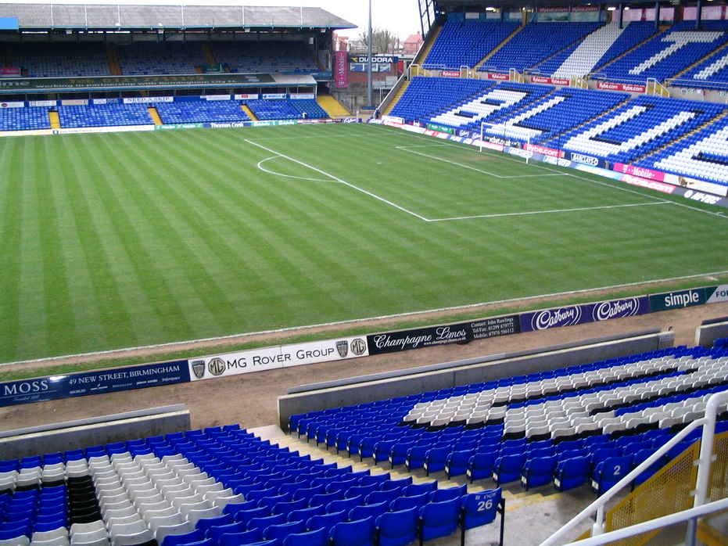
Home is the starting place of love, hope and dreams. BRIMINGHAM IS HOME.
ST ANDREWS SATDIUM,BORDESLEY

